Slide 1


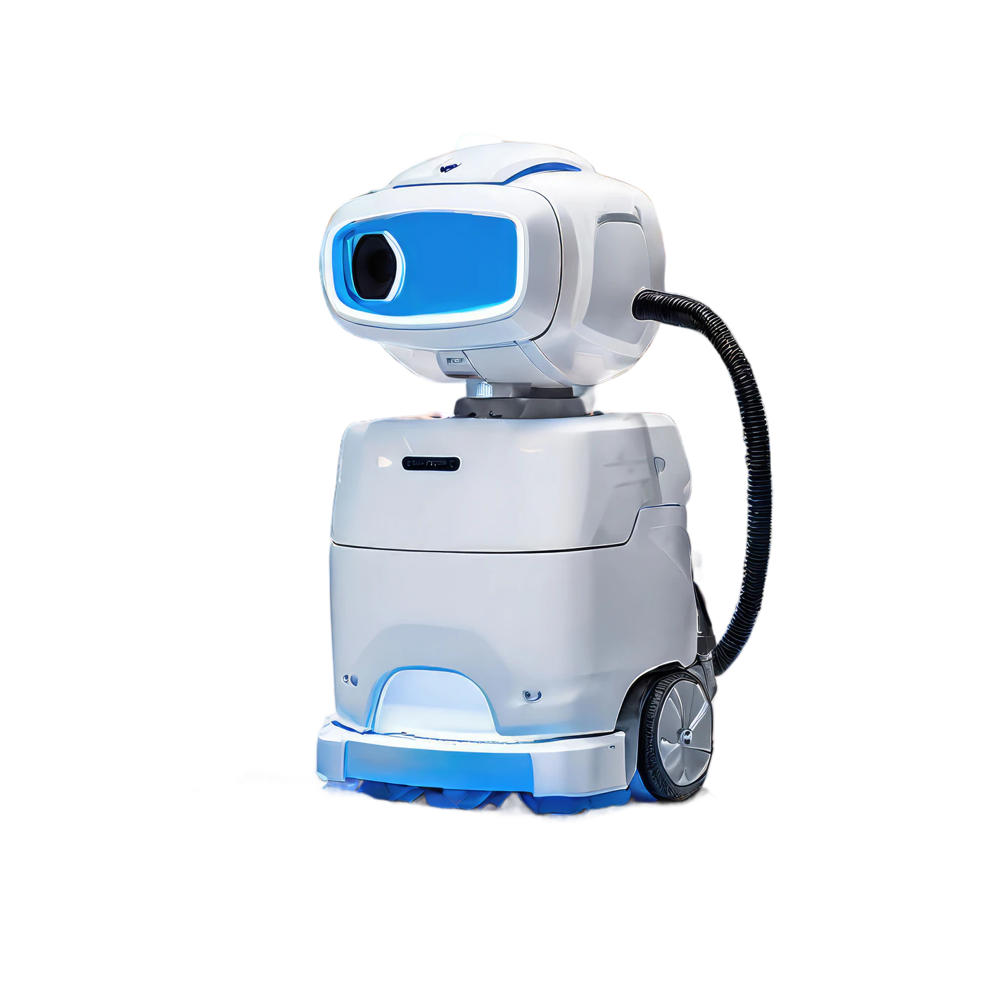
COLLEGE ENGINEERING SEMINAR
AI BASED AUTONOMOUS ROBOT NAVIGATION
PRESENTED BY
Atharva Kadam — 23
Aryan Kochale — 31
Rishit Kotian — 35
Aaryan Lad — 36

Slide 2






01 — OVERVIEW
Introduction
An autonomous robot is a machine that can sense its surroundings and move on its own — without any human driver or remote control.
Robot navigation means finding a safe, collision-free path from a start point to a destination. AI helps the robot understand sensor data, make smart real-time decisions, and adapt when the environment changes.
THE SIMPLE IDEA
SENSE
→
UNDERSTAND
→
DECIDE
→
MOVE

Slide 3







02 — PROCESS
How Does Autonomous Navigation Work?
The robot repeats seven core steps in a continuous loop — sensing, perceiving, locating, deciding, planning, moving and learning from feedback — to reach its goal safely.
SENSORS
PERCEPTION
LOCALIZATION
AI DECISION
PATH PLANNING
MOTOR CONTROL
FEEDBACK
↻ The loop repeats continuously — feedback returns to sensing so the robot keeps adapting in real time.

Slide 4

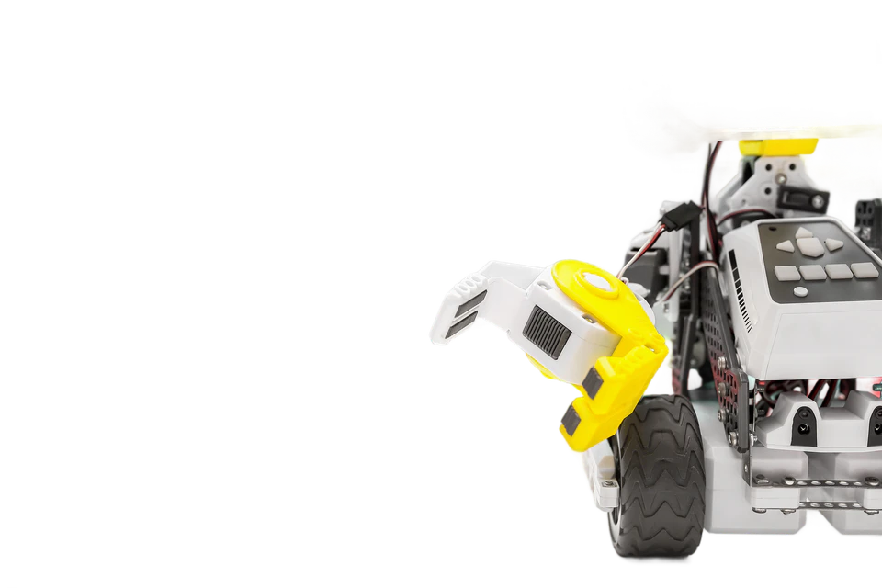
03 — HARDWARE
Sensors Used by Autonomous Robots
📷 Camera
🧭 IMU
Sees objects, signs, colours and lanes.
Tracks motion, tilt and balance.
📡 LiDAR
🛰️ GPS
Measures exact distances using laser beams.
Gives outdoor location on a global map.
🔊 Ultrasonic Sensor
⚙️ Wheel Encoders
Detects nearby obstacles at short range.
Measure wheel rotation and travel speed.
SENSOR FUSION — combining all sensor data for one accurate view of the world.

Slide 5




04 — INTELLIGENCE
Role of AI in Autonomous Navigation
AI turns raw sensor data into smart, safe action. It helps the robot to:
SENSOR DATA
RECOGNIZE objects, people, signs and paths
UNDERSTAND the surrounding scene and context
DECIDE the safest and shortest route to follow
ADAPT instantly to moving obstacles and changes
↓
AI / ML
↓
DECISION
→
ACTION

Slide 6






05 — SLAM
Mapping and Localization
MAPPING
TOP-VIEW MAP
Building a map of the area — walls, rooms and obstacles.
LOCALIZATION
Knowing exactly where the robot is on that map.
SLAM
Simultaneous Localization And Mapping — the robot builds the map and finds its own position at the same time. Example: a vacuum robot mapping a new home while cleaning it.
ROBOT
Robot + Sensors → Environment → Map → Location

Slide 7




06 — PLANNING
Path Planning & Obstacle Avoidance
PLANNING METHODS
— planned path (blue) ⋯ blocked (grey)
A* — fast, efficient shortest-path search
Dijkstra — guaranteed shortest route
RRT — quick paths in complex, cluttered spaces
AI / ML — learns from experience and improves routes
DESTINATION
OBSTACLE AVOIDANCE
OBSTACLE
DETECT → ANALYZE → DECIDE → AVOID → CONTINUE
START

Slide 8

07 — IN THE REAL WORLD
Real-Time Navigation & Applications
Real-time example: when a person suddenly steps in front, the robot instantly re-plans its path and moves safely around them — all within milliseconds.
WHERE IT IS USED
🏭 Warehouse Robots
📦 Delivery Robots
🚗 Self-Driving Vehicles
Move goods automatically.
Carry parcels to the door.
Drive with no human.
🌾 Agricultural Robots
🏥 Hospital Robots
🚨 Search & Rescue Robots
Plant and harvest crops.
Deliver medicine & supplies.
Reach dangerous areas.

Slide 9


08 — ANALYSIS
Advantages, Challenges & Future Scope
ADVANTAGES
CHALLENGES
FUTURE SCOPE
✔ Works without human control
✔ Higher accuracy and safety
✔ Saves time and cost
✔ Works 24/7 without tiring
✔ Reduces human error
⚠ Complex changing environments
⚠ High hardware cost
⚠ Sensor errors and noise
⚠ Needs heavy computing power
⚠ Safety in crowded places
★ Smarter self-learning AI
★ Better multi-sensor fusion
★ Cheaper, faster hardware
★ Fully autonomous cities
★ Wider use in daily life

Slide 10


THANK YOU
Any Questions?
Prof. Sanchita Bhoi
Signature

